Slide 1
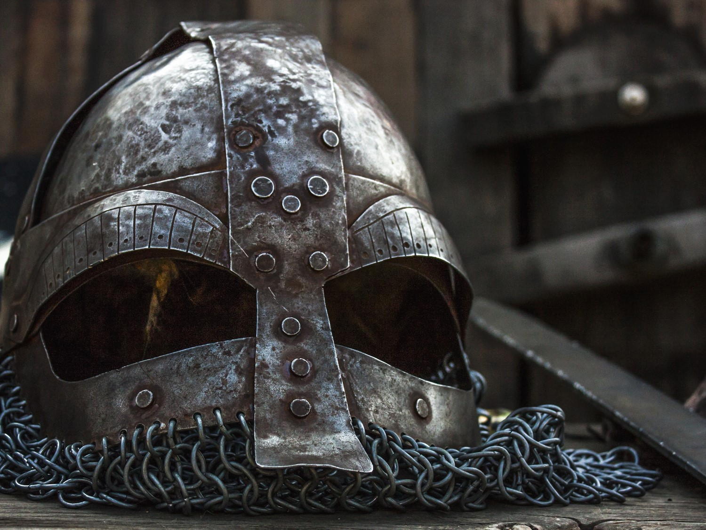

The Rise of Feudalism in Europe During the Middle Ages

Slide 2
The Middle Ages or Medieval Period
(500 CE -1500 CE)
Rise of
new
kingdoms/states that are not united
New kingdoms are unable to protect themselves from
barbarian
invasions, causing a need for localized protection
Barbarian invasions and political corruption cause the
fall of the Western Roman Empire
The
rise of feudalism in Europe

Slide 3
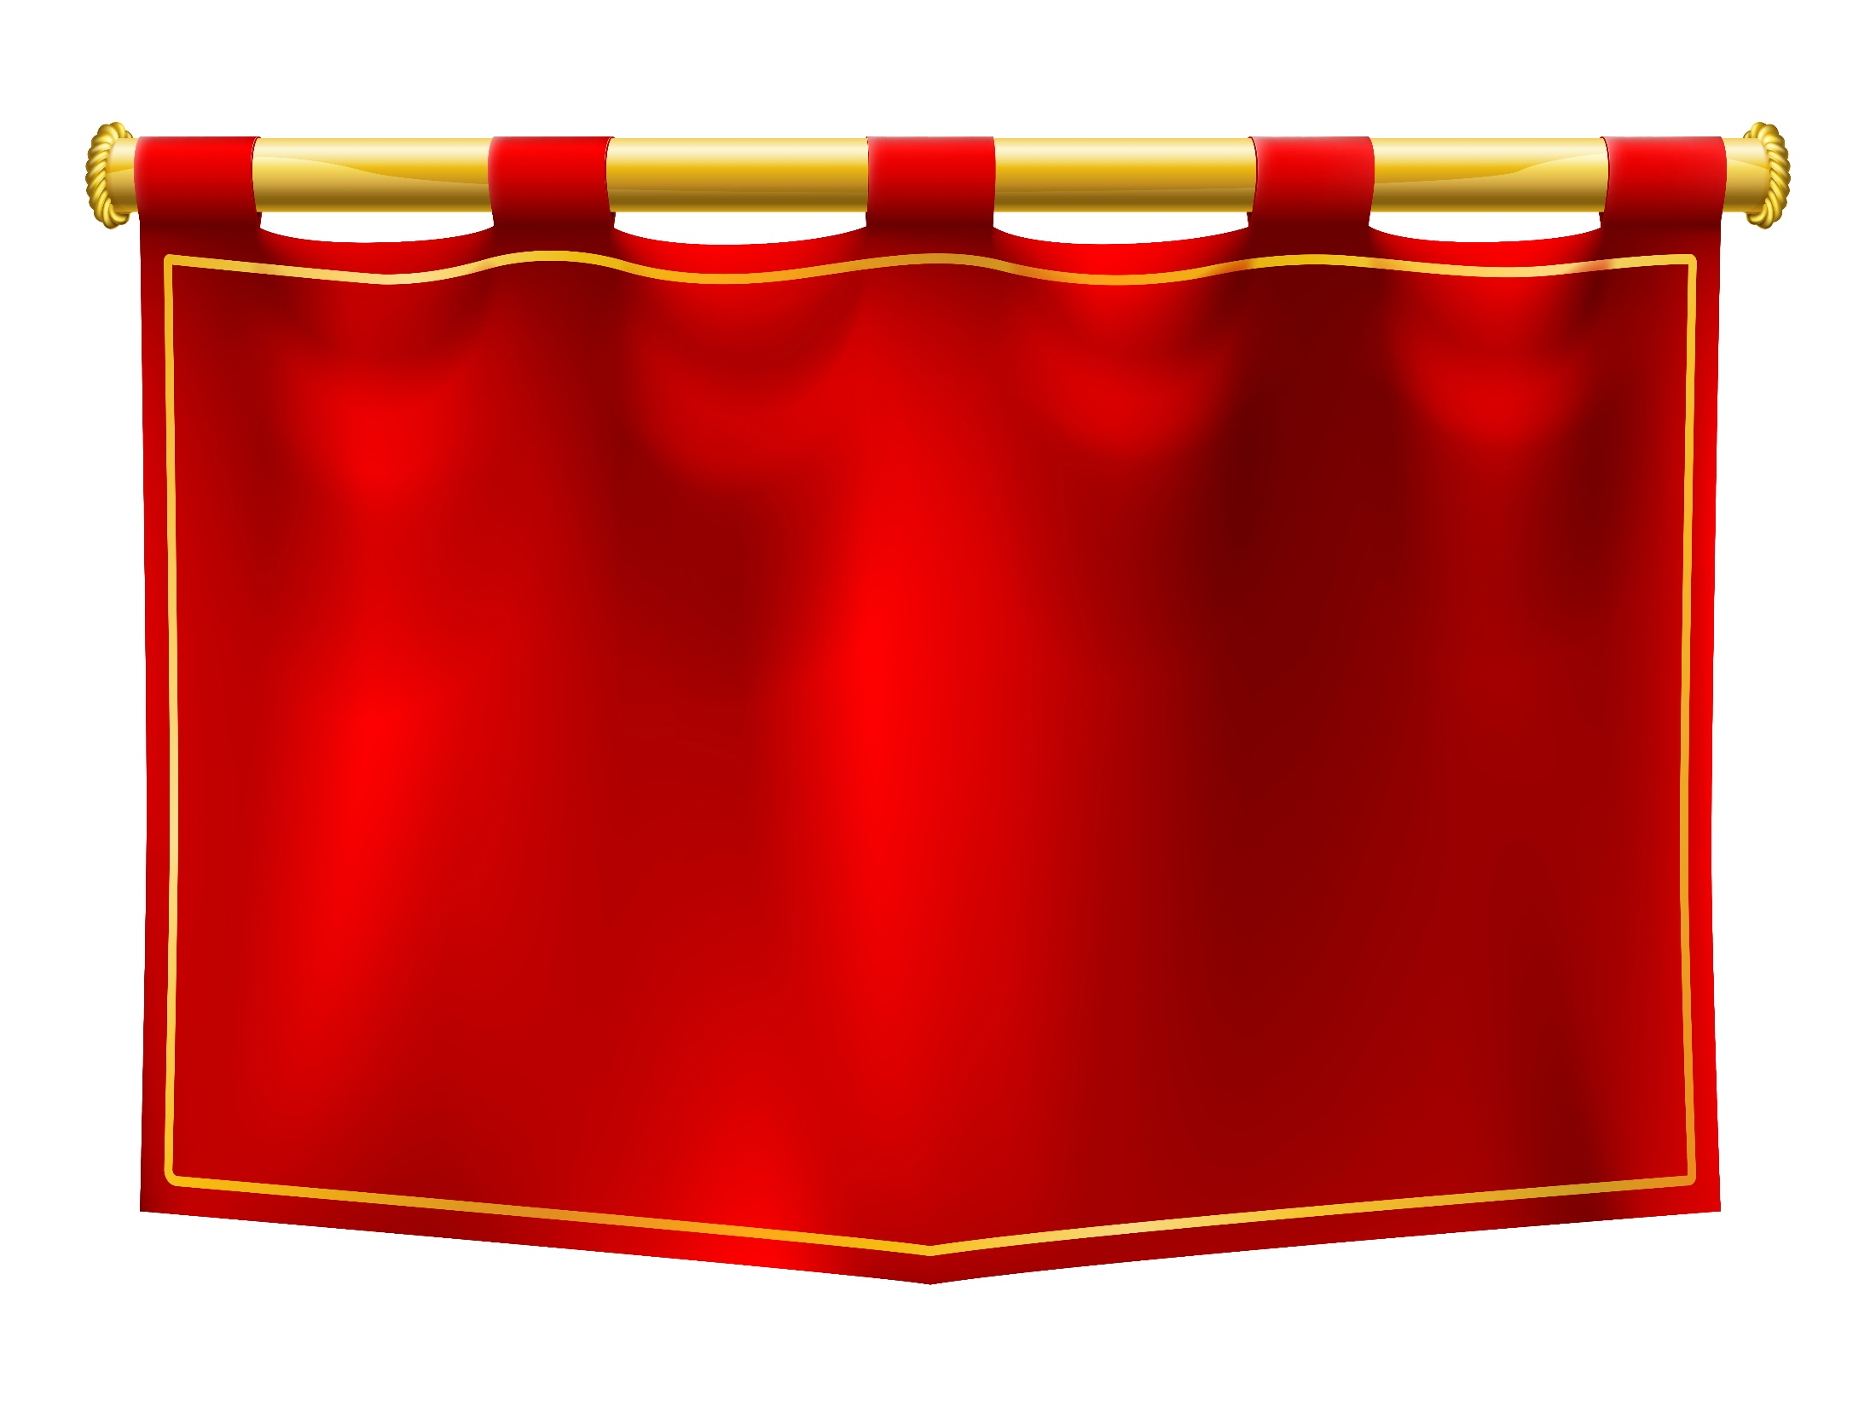
Key Words Essential to Feudalism
Feudalism- (Fyoo-duh-lih-zuhm) A system of PROTECTION in the Middle Ages.
Vassal-An oath of loyalty between knights and lords that stated they would protect the land.
A knight is a vassal (loyal subject) for his lord and a lord is a vassal for a king.

Slide 4

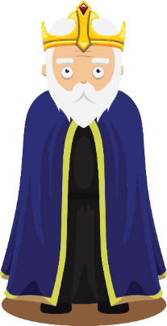
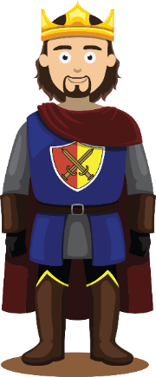
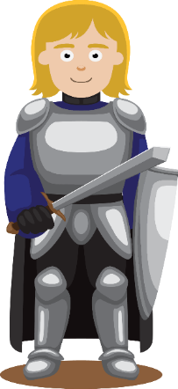

Feudal Europe Power Pyramid
The Pope
King
Lords/Nobles
Knights/Vassals
Peasants/Serfs

Slide 5

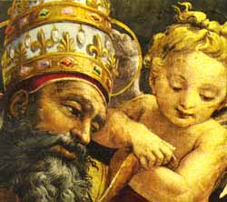
Popes
Leader of the Roman Catholic Church
Popes were seen as God’s representative on earth

Slide 6
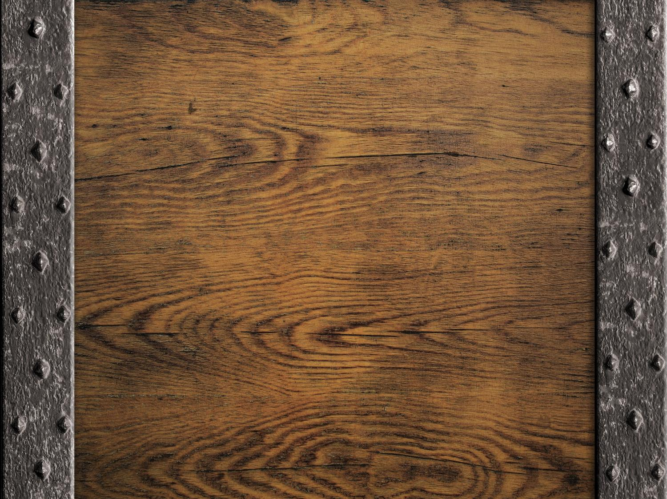
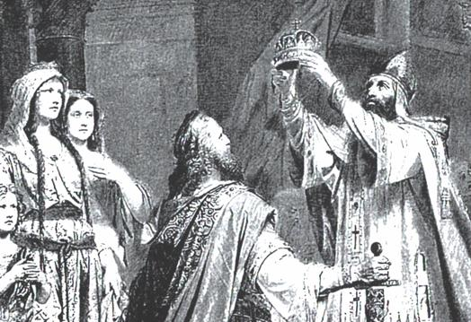
Kings
Leader of kingdoms
Kings gave land to the lords
All lords/nobles and knights swore an oath of loyalty to protect the king’s land
.

Slide 7

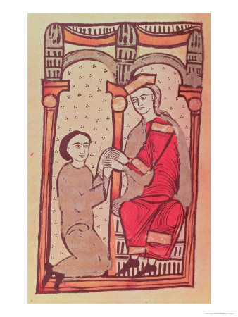
Nobles/Lords
Swore loyalty to the king
In exchange, nobles were given land called fiefs to protect

Slide 8
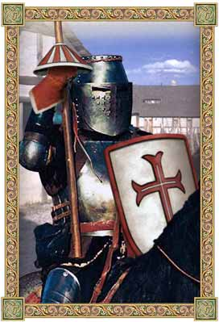
Knights
Armored warriors that protected their lord’s land
They often received “fiefs”(land) for their service

Slide 9
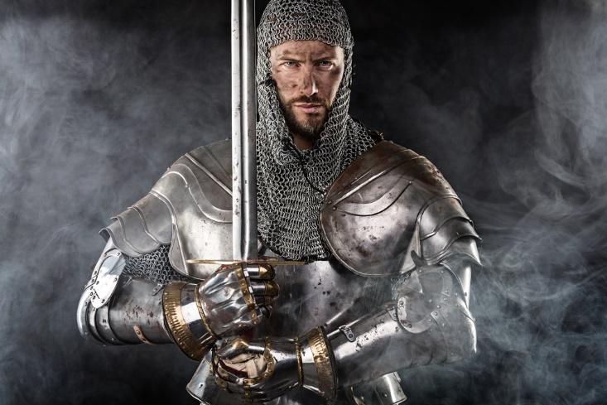
I promise to protect my lord’s land with a code of conduct called chivalry!

Slide 10
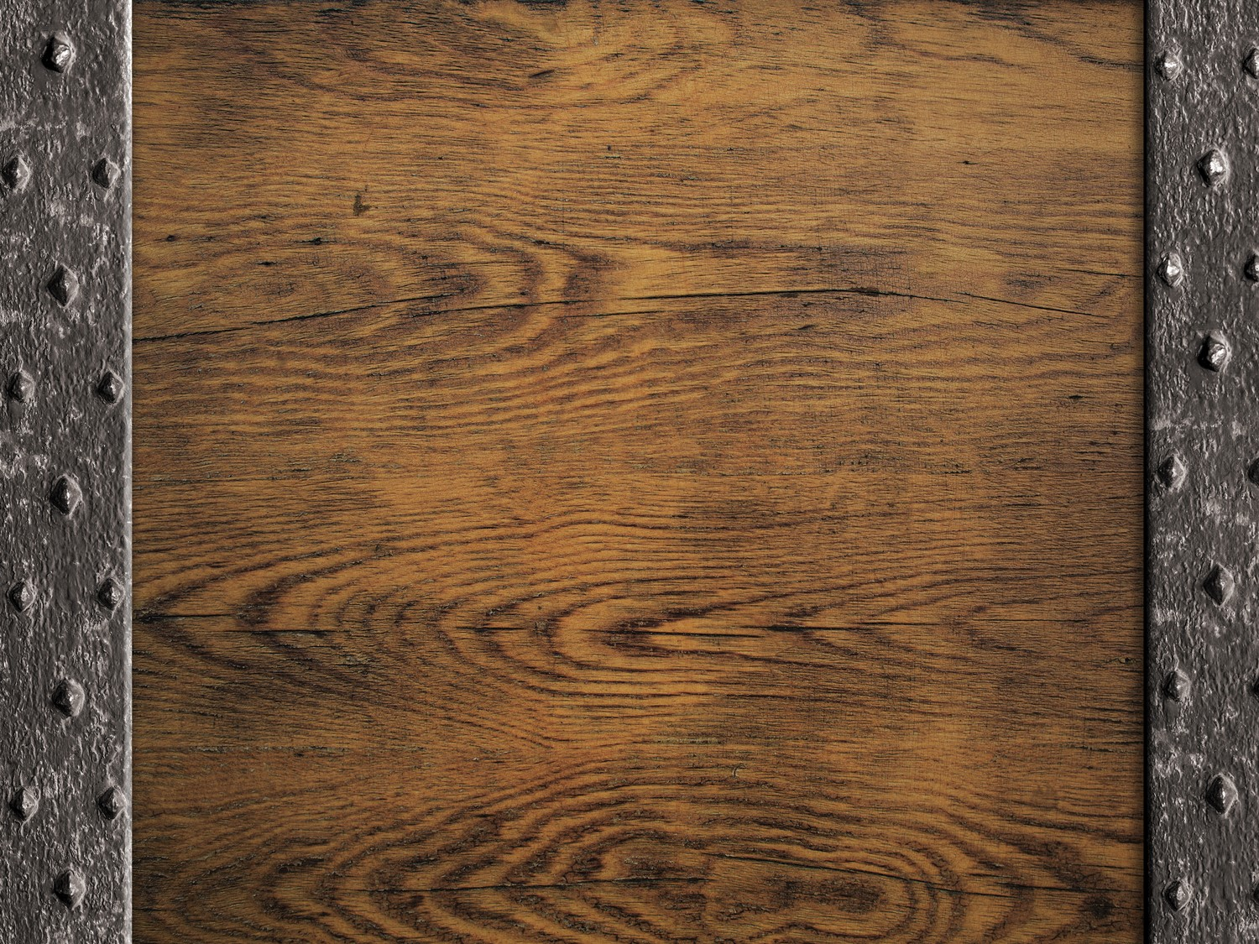
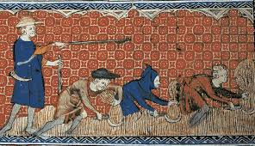
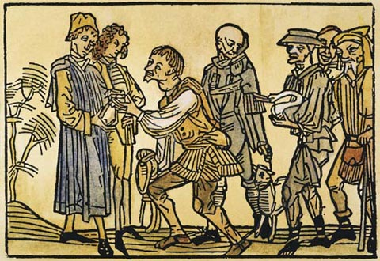
Peasants
Worked on the lord’s land (manors) growing and harvesting food for the feudal system
Received protection for their service

Slide 11
Check for Understanding: What did knights receive in exchange for their oaths of loyalty?
A pay check
A fief
A title
A weapon
30
of
30

Slide 12
Check for Understanding: A manor was a large estate owned by a…
32
30
A knight or peasant
A daimyo or samurai
A knight or lord
Peasants or farmers

Slide 13
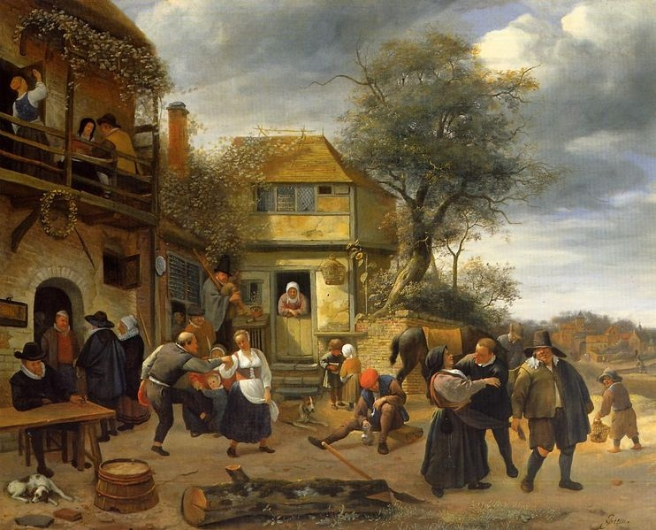
Do you think this picture is accurate? Why or why not?

Slide 14
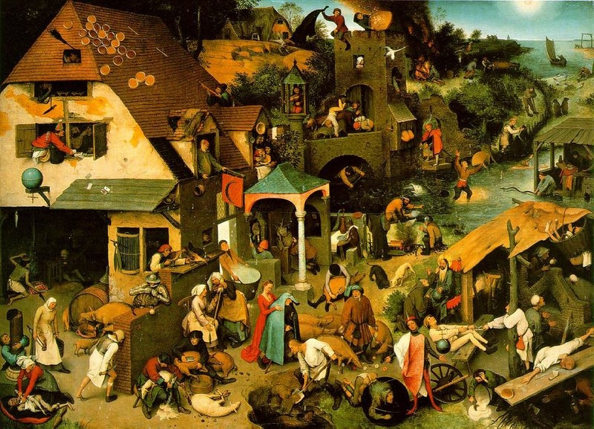
Do you think this picture is more or less accurate than the previous? Why or why not?

Slide 15

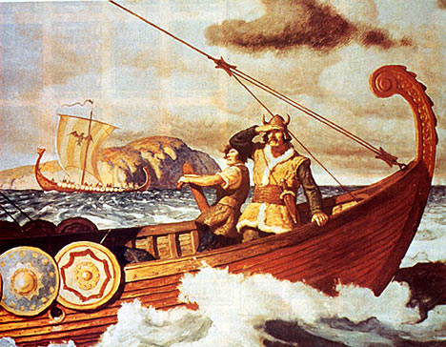
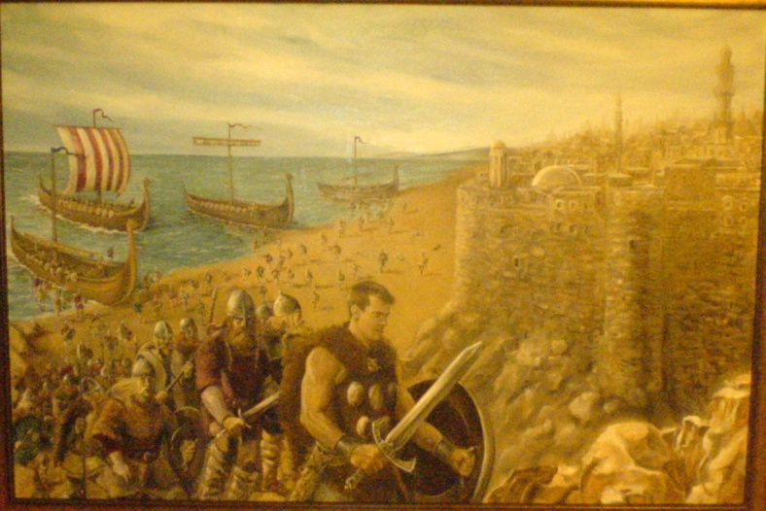
England and France Need Protection!
The Vikings invaded from Scandinavia- They were expert sailors that were quick and savage. Vikings attacked Ireland, England and France. They looted and captured people to sell into slavery. Most Europeans lived in terror of them.
The Magyars attacked from Asia.
The Muslims attacked (from south).

Slide 16
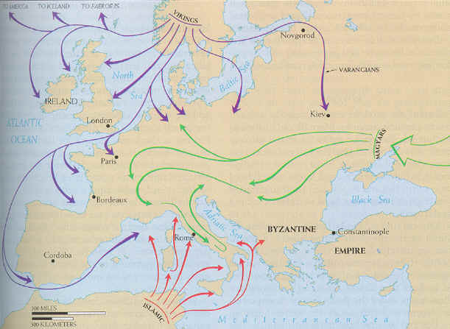
Vikings, Muslims and Magyars Invasion Map

Slide 17
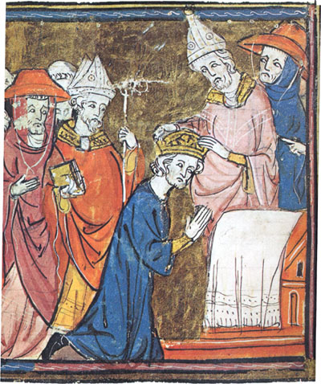

Charlemagne
Charlemagne was first crowned king of the Franks.
Later, in 800 CE he was crowned by the POPE Leo III as the Holy Roman Emperor.
This enraged the people of the Eastern Byzantine Empire because their ruler was not selected!
The Church and Charlemagne depended on each other:
The Pope needed the support of his army to protect the Church.
Charlemagne gained support from his people because he was viewed as having “God on his side”.

Slide 18

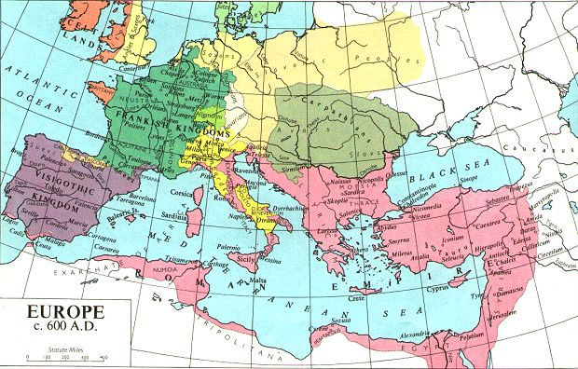
Frankish Kingdoms

Slide 19
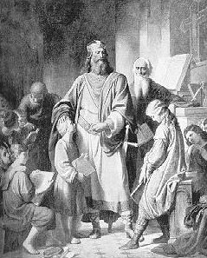
Charlemagne Continued
Through wars of conquest he united differing European tribes
He showed the tribes of Europe that they had similar values under Christianity

Slide 20
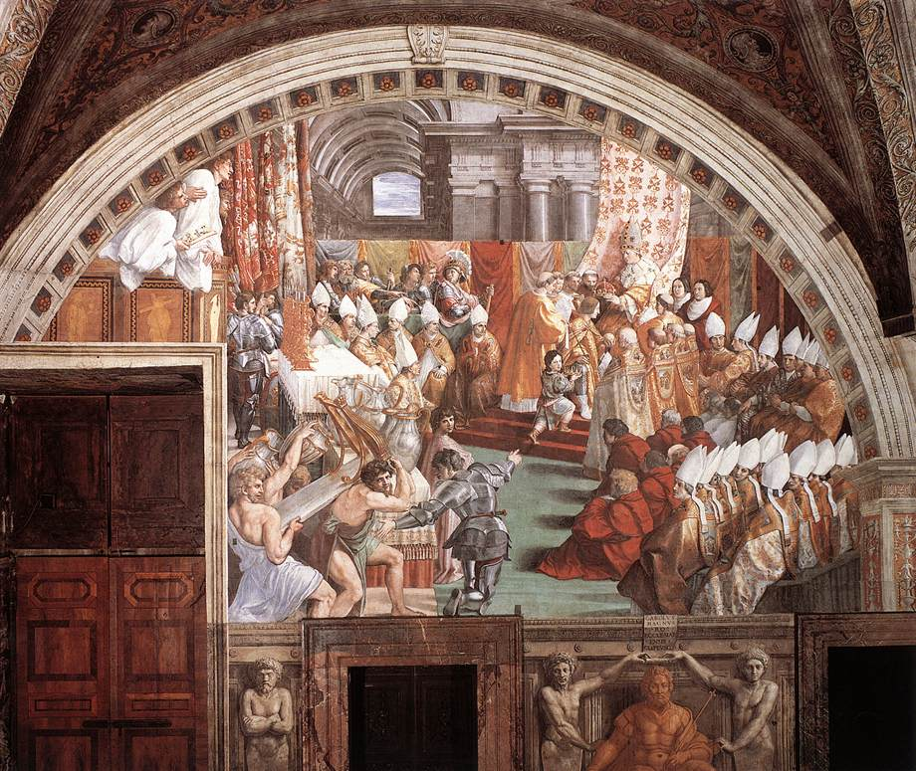
By Rafael: the Coronation of Charlemagne

Slide 21
Check for Understanding: Invaders from Scandinavia who attacked Europe during the 700 and 800s were called…
Vikings
Muslims
Magyars
Samurai
34
of
34

Slide 22
Check for Understanding: Who built a European Christian Empire and was crowned Emperor of the Holy Roman Empire in the year 800 CE?
33
32
Clovis
St Patrick
Pope Leo III
Charlemagne

Slide 23
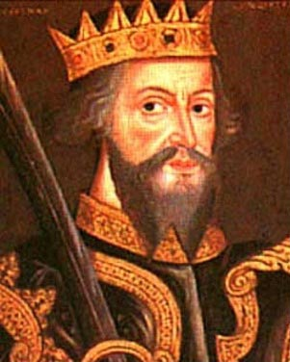
William The Conqueror
A French duke who defeated the English king at the Battle of Hastings
After winning the battle he declared himself king of England
William rewarded the knights that helped him win the battle by giving them land
This event marked the beginning of the feudal system in England

Slide 24
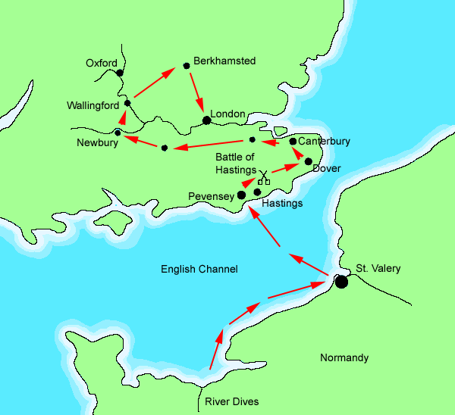
The Battle of Hastings Map

Slide 25
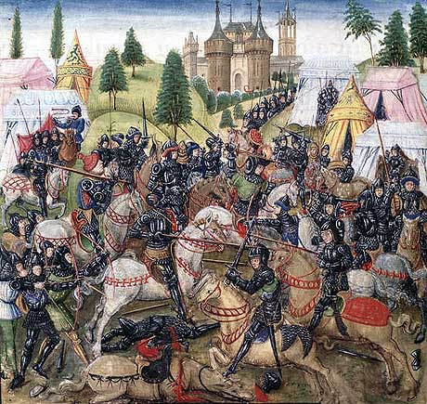
Battle of Hastings

Slide 26
Check for Understanding: Feudalism began to spread to England soon after…
34
33
Charlemagne was crowned emperor of the Romans
The Vikings began raiding northern Europe
William the Conqueror invaded England and won the Battle of Hastings
Eleanor of Aquitaine married King Henry II of England

Slide 27
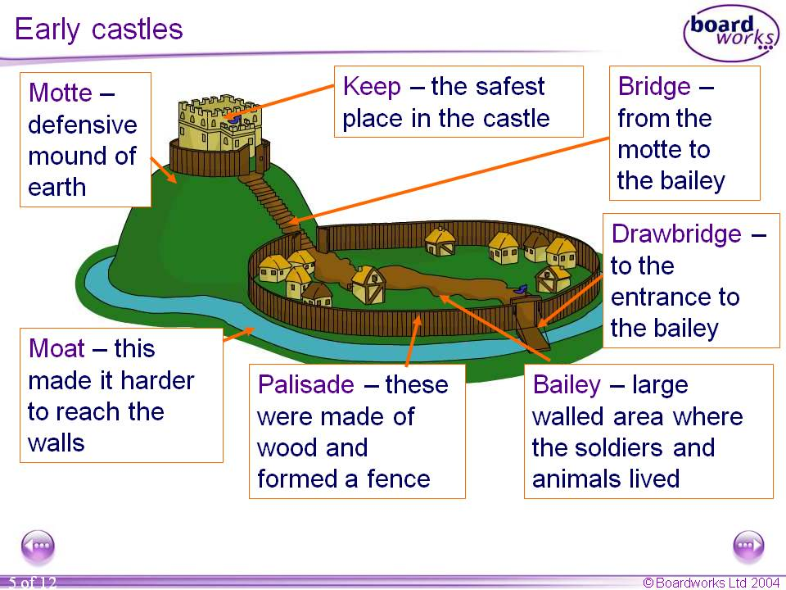
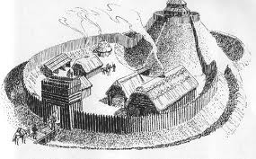
The First Castle Design: Motte and Bailey

Slide 28
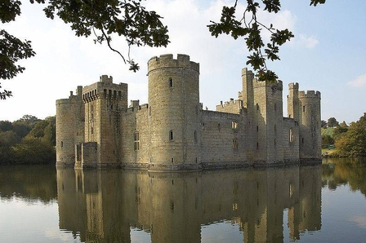
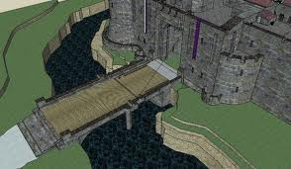
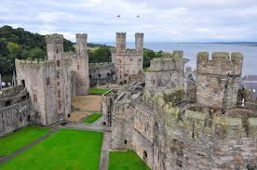
More Advanced Castled Designs
Caernarfon Castle

Slide 29
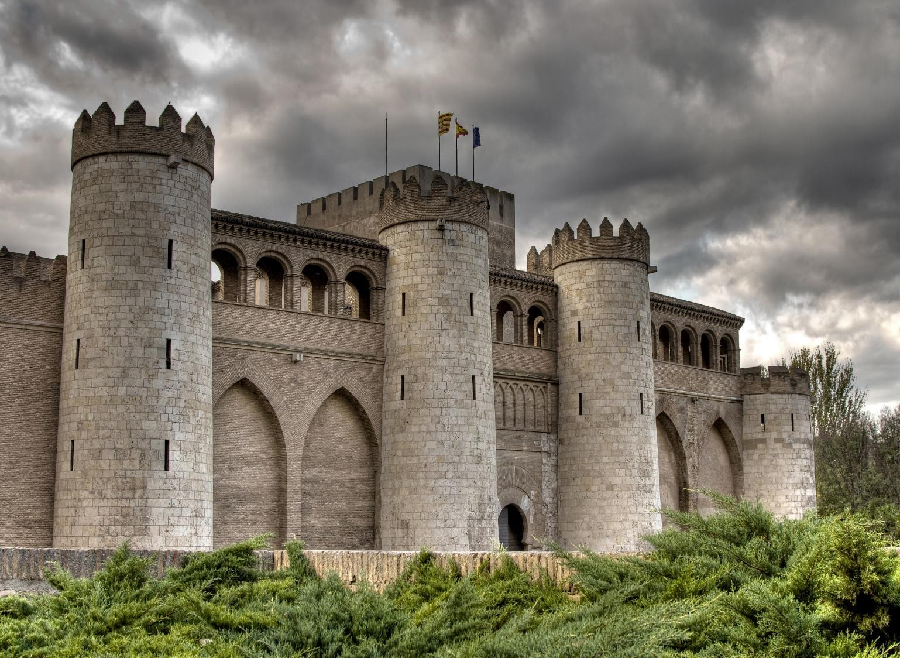

Slide 30
Youtube Link
The Castle by David Macaulay
http://www.youtube.com/watch?v=JGbPShUpjpg&list=PLA9C3672CED7D4327
Play from about 14 minutes to 17.

